Slide 1
Natural Language Understanding
Jian Tang
HEC Montreal
Mila-Quebec AI Institute
Email: jian.tang@hec.ca

Slide 2

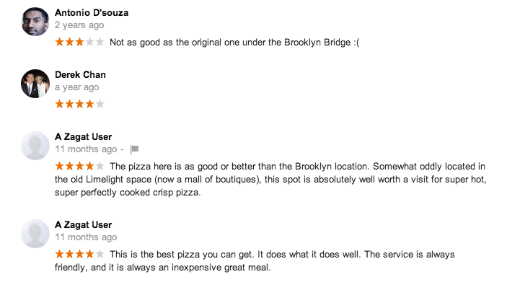



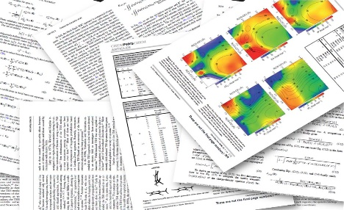

A Huge Amount of Unstructured Text
Traditional media
Social media
Electronic Health Records

Slide 3

Document (Sentence) Classification
Topic classification
Sentiment classification

Slide 4


Document Clustering

Slide 5
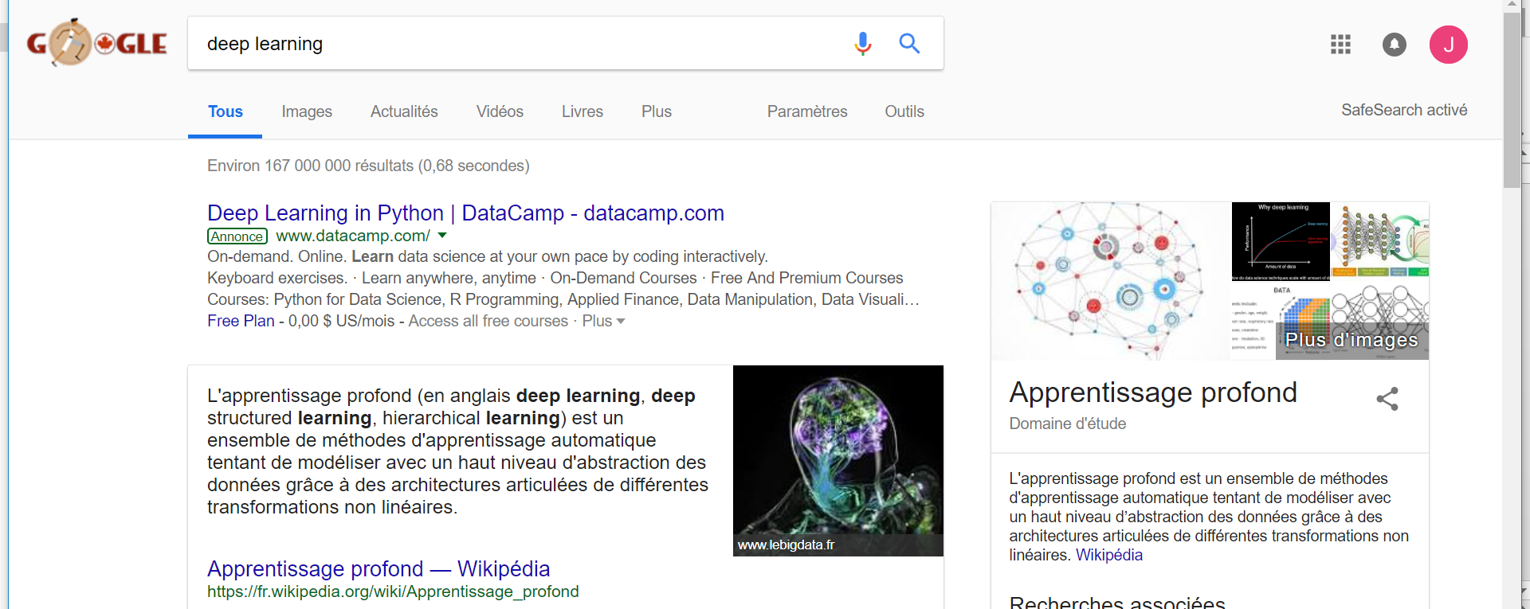
Information Retrieval

Slide 6
Question Answering

Slide 7
Text Summarization

Slide 8

Dialogue Systems

Slide 9
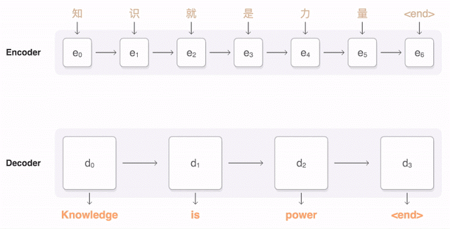
Machine Translation

Slide 10
Research Questions
How to effectively learn the representations of words, phrases, sentences and documents?
How to generate nature language?

Slide 11
Classical Word Representations
Words as atomic symbols: “One-hot” representation
Documents: “Bag-of-words”
“network” = [0,1,0,0,0,0,0]
AND
0
“networks” = [0,0,0,0,1,0,0]
Ignore the semantic relatedness between words
The curse of dimensionality
As large as millions in a large text corpus.

Slide 12
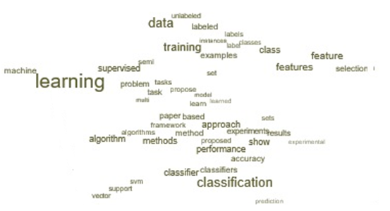
Neural Word Embeddings (Bengio et al. 2003)
Represent each word with a continuous dense vector
Hundreds or thousands of dimensions
Words with similar meanings are represented with similar vectors
Represent phrases, sentences and documents through word embedding

Slide 13
Distributional Hypothesis
“You shall know a word by the company it keeps” (J.R. Firth 1957:11)
The meaning of a word can be represented by its neighbors
A telecommunications network allows computers to exchange data
In information technology, a network is a series of points or nodes interconnected...
Represent “network” with the neighboring words

Slide 14
Word2VEC (Mikolov et al. 2013)
Skip-gram: finding word representations that are useful for predicting the surrounding words in a sentence or a document
A telecommunications network allows computers to exchange data
INPUT
PROJECTION
OUTPUT
w(t-2)
w(t)
w(t-1)
w(t+1)
w(t+2)

Slide 15
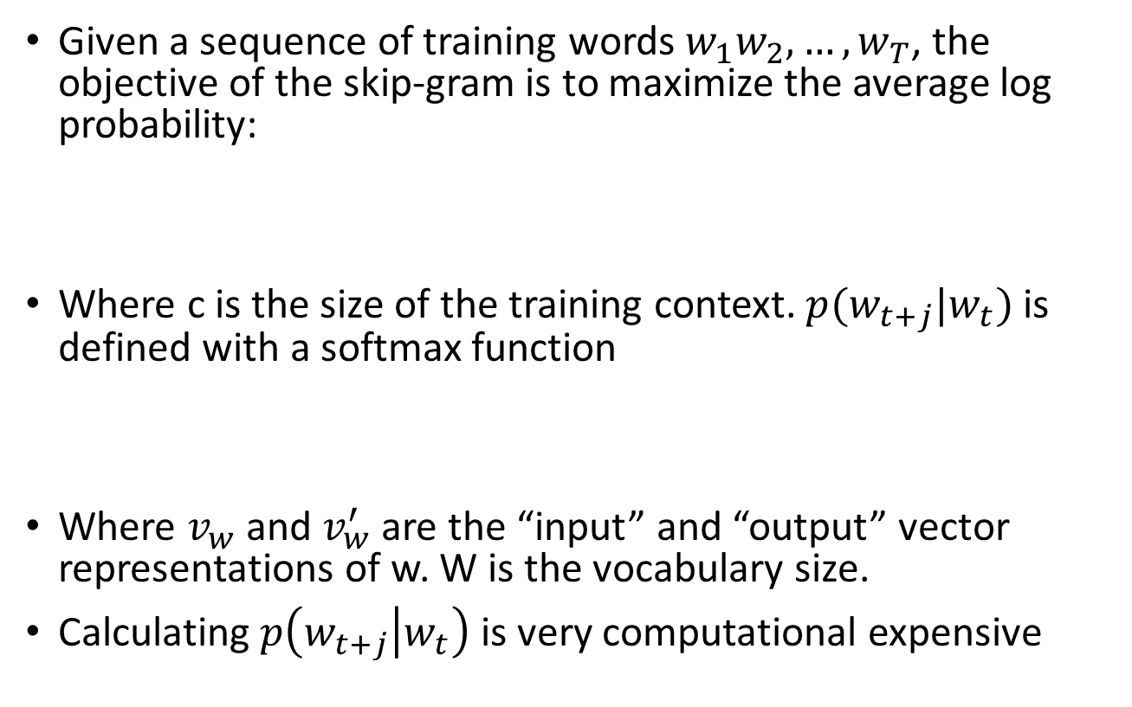
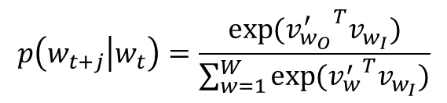
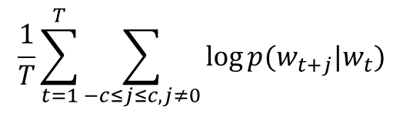
Objective of Skip-gram
Given a sequence of training words $w_{1}w_{2},…, w_{T}$, the objective of the skip-gram is to maximize the average log probability:
Where c is the size of the training context. $p(w_{t+j}|w_{t})$ is defined with a softmax function
Where $v_{w}$ and $v_{w}^{′}$ are the “input” and “output” vector representations of w. W is the vocabulary size.
Calculating $p\left(w_{t+j} | w_{t}\right)$ is very computational expensive
$$\frac{1}{T}\sum_{t=1}^{T}{\sum_{−c≤j≤c, j≠0}{\log{p(w_{t+j}|w_{t})}}}$$
INPUT
PROJECTION
OUTPUT
w(t-2)
w(t)
w(t-1)
w(t+1)
$$p\left(w_{t+j} | w_{t}\right)=\frac{\exp{({v_{w_{O}}^{′}}^{T}v_{w_{I}})}}{\sum_{w=1}^{W}{\exp{({v_{w}^{′}}^{T}v_{w_{I}})}}}$$
w(t+2)

Slide 16
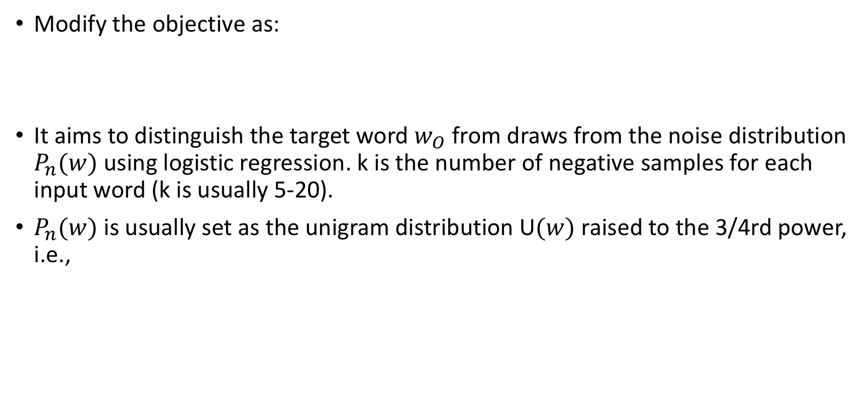
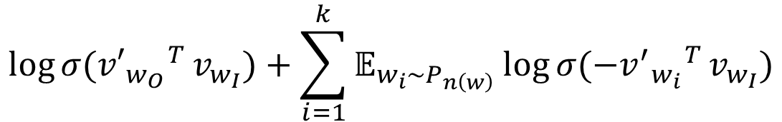
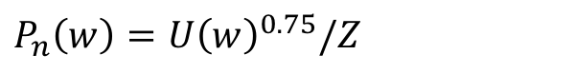
Negative Sampling (Mikolov et al. 2013)
Modify the objective as:
It aims to distinguish the target word $w_{O}$ from draws from the noise distribution $P_{n}(w)$ using logistic regression. k is the number of negative samples for each input word (k is usually 5-20).
$P_{n}(w)$ is usually set as the unigram distribution U$(w)$ raised to the 3/4rd power, i.e.,
$${\log{σ({v′}_{w_{O}}}}^{T}v_{w_{I}})+\sum_{i=1}^{k}{𝔼_{w_{i}\sim P_{n\left(w\right)}}{\log{σ({{−v}^{′}}_{w_{i}}}}^{T}v_{w_{I}})}$$
$P_{n}\left(w\right)=U{\left(w\right)}^{0.75}/Z$

Slide 17
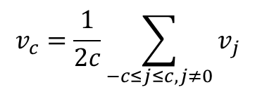
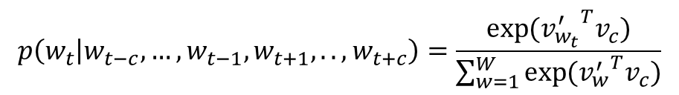
CBOW (Mikolov et al. 2013)
Instead of using center words to predict nearby words, using nearby words to predict the center words
Calculating the context embedding
Predict the center word:
INPUT
PROJECTION
OUTPUT
$$v_{c}=\frac{1}{2c}\sum_{−c≤j≤c, j≠0}{v_{j}}$$
w(t-2)
w(t-1)
w(t)
w(t+1)
$$p\left(w_{t} | w_{t−c},…, w_{t−1}, w_{t+1}, .., w_{t+c}\right)=\frac{\exp{({v_{w_{t}}^{′}}^{T}v_{c})}}{\sum_{w=1}^{W}{\exp{({v_{w}^{′}}^{T}v_{c})}}}$$
w(t+2)

Slide 18
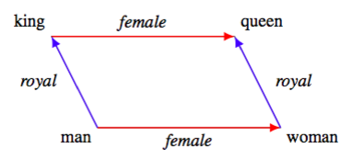
Word Analogy
Find a word that is similar to small in the same sense as biggest is similar to big.
Compute vector X = vector(“biggest”)-vector(“big”) + vector(“small”)
Then search the vector space for the word closest to X measured by cosine distance, and use it as the answer.

Slide 19
Examples

Slide 20
Word Embeddings in Pytorch
https://github.com/blackredscarf/pytorch-SkipGram
https://pytorch.org/tutorials/beginner/nlp/word_embeddings_tutorial.html

Slide 21
Neural Machine Translation

Slide 22
Sequence to Sequence
Text Summarization

Slide 23
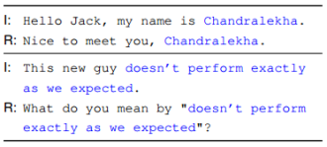
Sequence to Sequence
Dialogue systems

Slide 24
Sequence2Sequence (Encoder-Decoder)

Slide 25
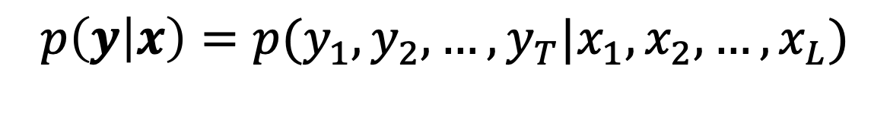
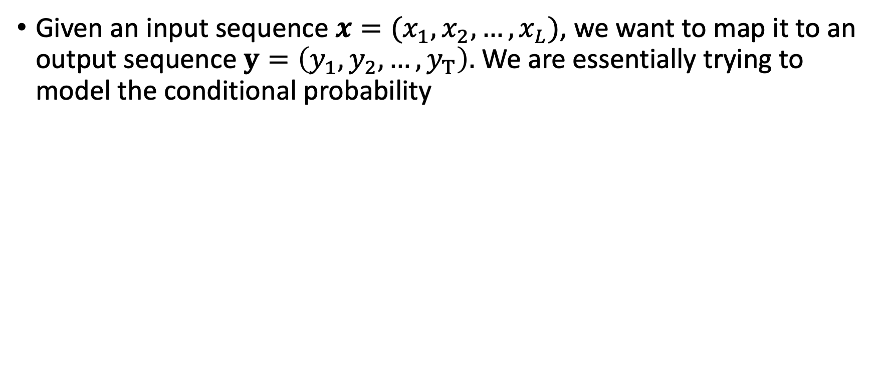
Sequence to Sequence Model
Given an input sequence $x=(x_{1},x_{2}, …, x_{L})$, we want to map it to an output sequence $y=\left(y_{1},y_{2}, …, y_{T}\right).$ We are essentially trying to model the conditional probability
$$p\left(y | x\right)=p(y_{1},y_{2}, …, y_{T}|x_{1},x_{2}, …, x_{L})$$

Slide 26
Sequence to Sequence (Encoder-Decoder)
Encoder
One Recurrent Neural Networks
Decoder
Another Recurrent Neural Networks

Slide 27
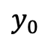
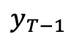
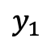
Encoder: one Recurrent Neural Network
C is the last hidden state of input
sequence
summary of the input sequence
$$y_{0}$$
$$y_{1}$$
$$y_{T−1}$$

Slide 28
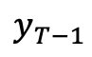
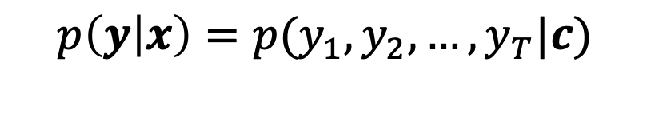

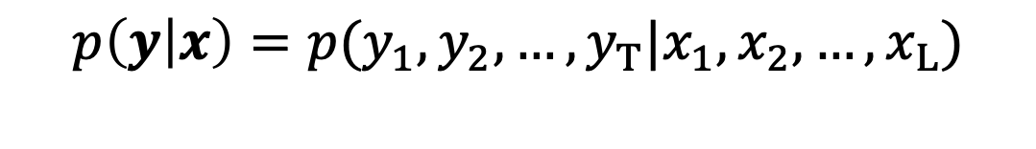
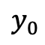
Decoder: another Recurrent Neural Network
Decode the output sequence y based on
the input sequence x
$$y_{0}$$
$$y_{1}$$
$$y_{T−1}$$
$$p\left(y | x\right)=p(y_{1},y_{2}, …, y_{T}|x_{1},x_{2}, …, x_{L})$$
$$p\left(y | x\right)=p(y_{1},y_{2}, …, y_{T}|c)$$

Slide 29
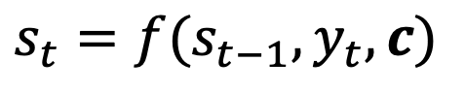
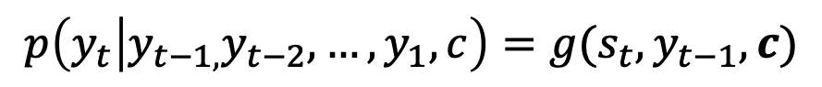
Decoder
The hidden representation:
The conditional distribution of next symbol
$$s_{t}=f(s_{t−1}, y_{t}, c)$$
$$p\left(y_{t} | y_{t−1,}y_{t−2}, …, y_{1},c\right)=g(s_{t}, y_{t−1},c)$$

Slide 30
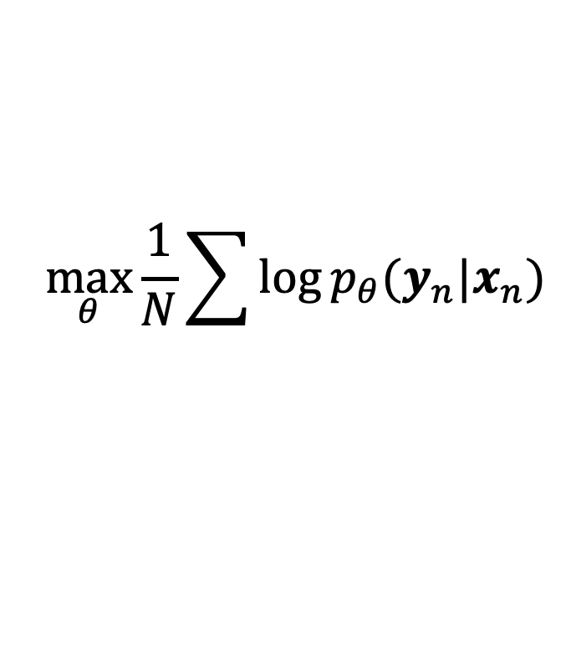
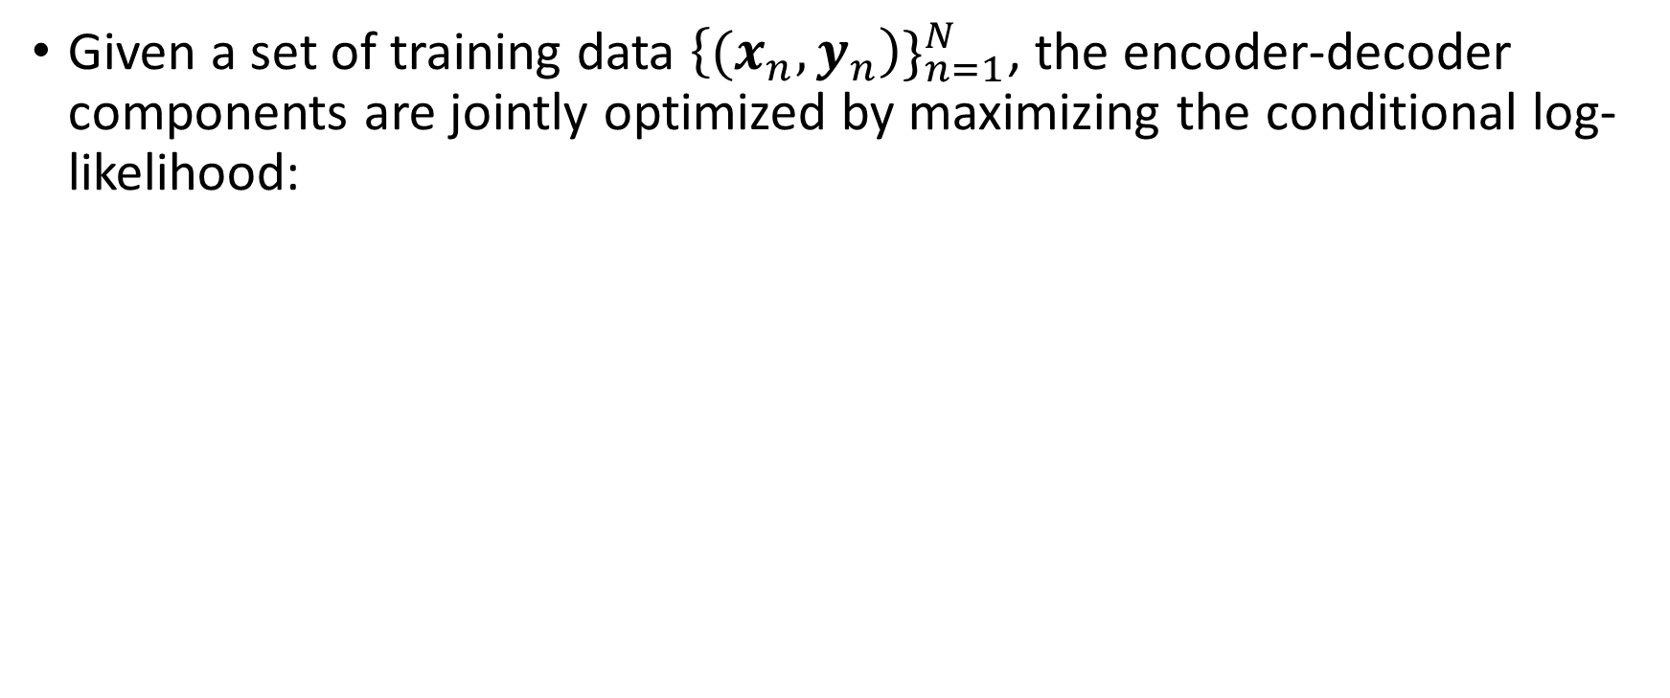
Optimization with Maximum Likelihood
Given a set of training data ${\left\{{(x}_{n},y_{n}\right)\}}_{n=1}^{N}$, the encoder-decoder components are jointly optimized by maximizing the conditional log-likelihood:
$$\max_{θ}{\frac{1}{N}\sum{\log{p_{θ}(y_{n}|x_{n})}}}$$

Slide 31
Results on Machine Translation
Both encoder and decoder are RNNs
Table: Results from English to French

Slide 32
Worde Embeddings Learned by Seq2Seq

Slide 33
Phrase Embeddings Learned by Seq2Seq
Phrase embeddings are encoded with the summary vector c

Slide 34
Seq2Seq in Pytorch
https://github.com/bentrevett/pytorch-seq2seq/blob/master/2%20-%20Learning%20Phrase%20Representations%20using%20RNN%20Encoder-Decoder%20for%20Statistical%20Machine%20Translation.ipynb

Slide 35
Thanks!

